Slide 1
OLIST STORE E-COMMERCE ANALYSIS
GROUP NO :3
SHIVANAND SONMANKAR
YASH RAUL
SARAVANTHI UPPULURI
ASHWANTH C
SIDDHARTH SHRIVASTAVA
KUSHI PRASAD
AMUL GUMPULA

Slide 2
introduction
Olist is a Brazilian e-commerce company, and this project analyzes the Olist E-commerce Public Dataset As data analysts, our goal is to explore, clean, and analyze the data to uncover insights into customer behavior, sales patterns, product popularity, seller performance, and delivery efficiency.
Through Exploratory Data Analysis (EDA), we aim to identify trends, answer key business questions, and provide actionable recommendations to improve decision-making, operational efficiency, customer satisfaction, and overall business growth.
The dataset includes details on orders, payments, customers, products, sellers, deliveries, and reviews, enabling a holistic view of Olist’s e-commerce performance.

Slide 3
objectives
Our main objectives for this project are as follows :
Identify the top products contributing to revenue and the leading product category.
Enhance our understanding of customer purchase behavior through market basket analysis.
Determine which items are most likely to be purchased individually or in combination with other products

Slide 4
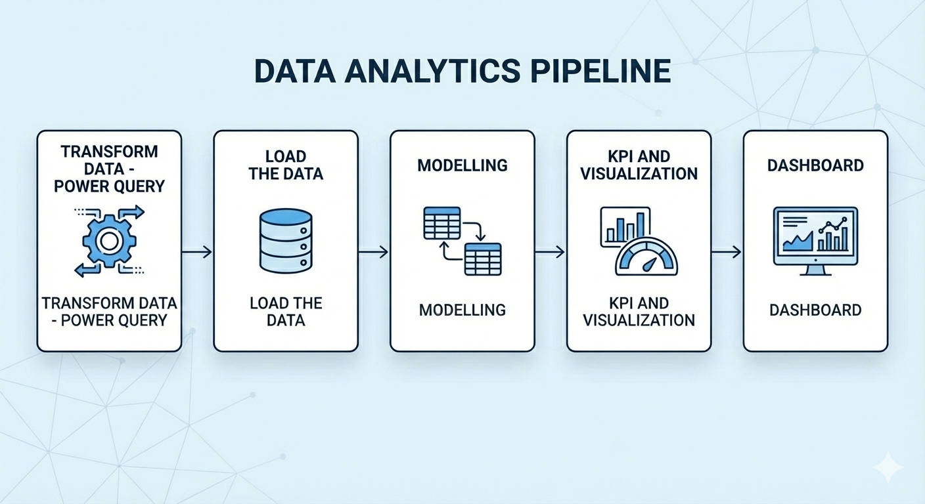
Project process
Extract data
Transform data
Load & using tools
KPI & Visualization
Dashboard

Slide 5
Olist store analysis
Olist Store Analysis -Customer Behavior, Payments, Delivery, and Review Insights
This dashboard is built using the Olist Brazilian E-Commerce Dataset, which contains real customer orders, payments, reviews, products, and delivery information.
The goal is to analyze customer behavior, payment patterns, delivery performance, and satisfaction using 5 key KPIs.

Slide 6
Olist store analysis
Key KPIs in this Report:
Orders & Payment Patterns-Compare Weekday vs Weekend orders and Payment Type usage.
5 Credit Card Orders -Analyze orders with Review Score 5 paid via Credit Card, across categories, states, and mouths.
Delivery Performance-Calculate Arg Delivery Days overall and for the Pet Shop category, with distribution by state.
São Paulo Payment Analysis-Compare Avg Payment & Order Trends of customers from São Paulo city
Shipping Impart on Reviews-Study the relationship between delivery speed and customer satisfaction, Inking Avg Shipping Days with Review Scores

Slide 7
challenges
Large dataset with missing and duplicate values
Difficulty in joining multiple tables in SQL
Understanding business metrics like delivery delay and customer retention
Dashboard alignment and performance issues

Slide 8
How We Resolved Them
Cleaned data using Excel and Power BI
Practiced SQL joins and verified results step by step
Referred documentation and tutorials
Team discussions and task sharing helped us overcome issues

Slide 9
insights
Order Volume & Delivery Olist handled-99,440 orders, with -90% delivery success rate.
Product Ratings Average rating is 4.09 stans some categories rate as high as 4.67, others as low as 2.5.
Quality Concerns-store reviews rank 3rd most common, suggesting product quality or delivery issues.
Customer Behavior Sales patterns highlight Interest in specific product categories and regions.
Business Opportunities& targeted marketing can boost growth

Slide 10
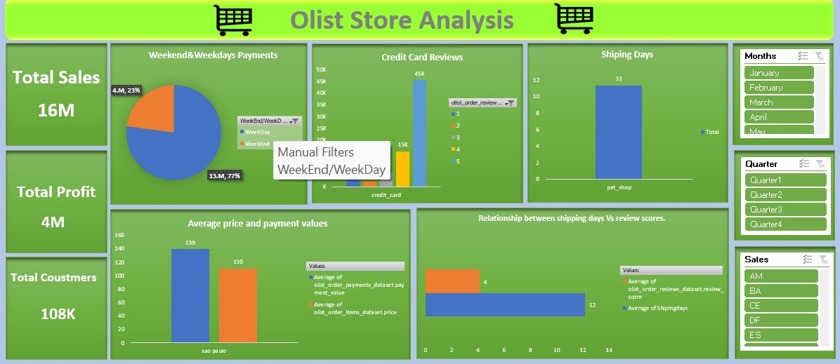
Excel dashboard

Slide 11
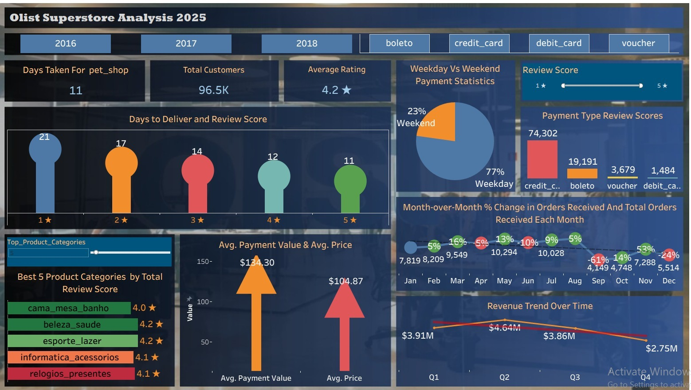
Tableau dashboard

Slide 12
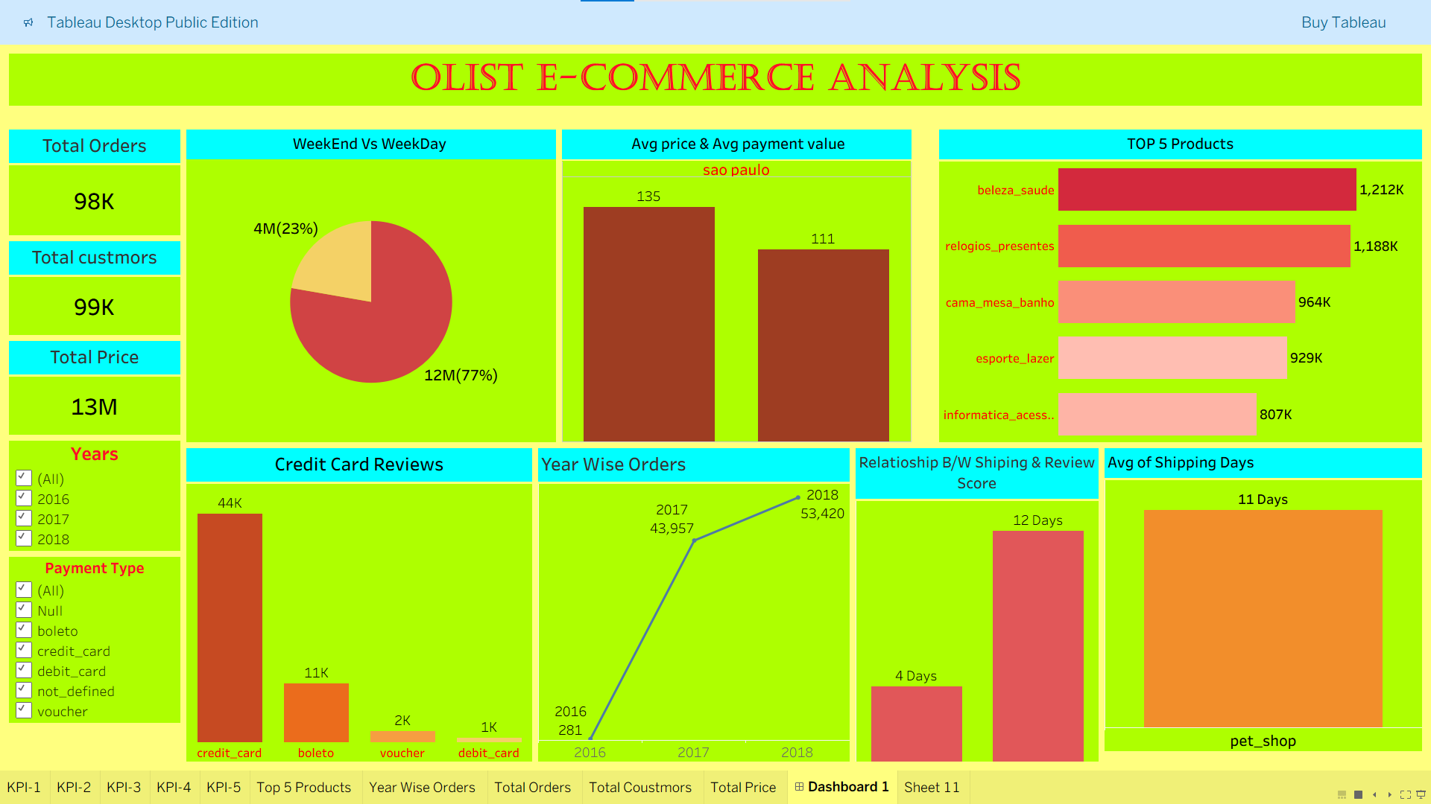
Tableau dashboard

Slide 13
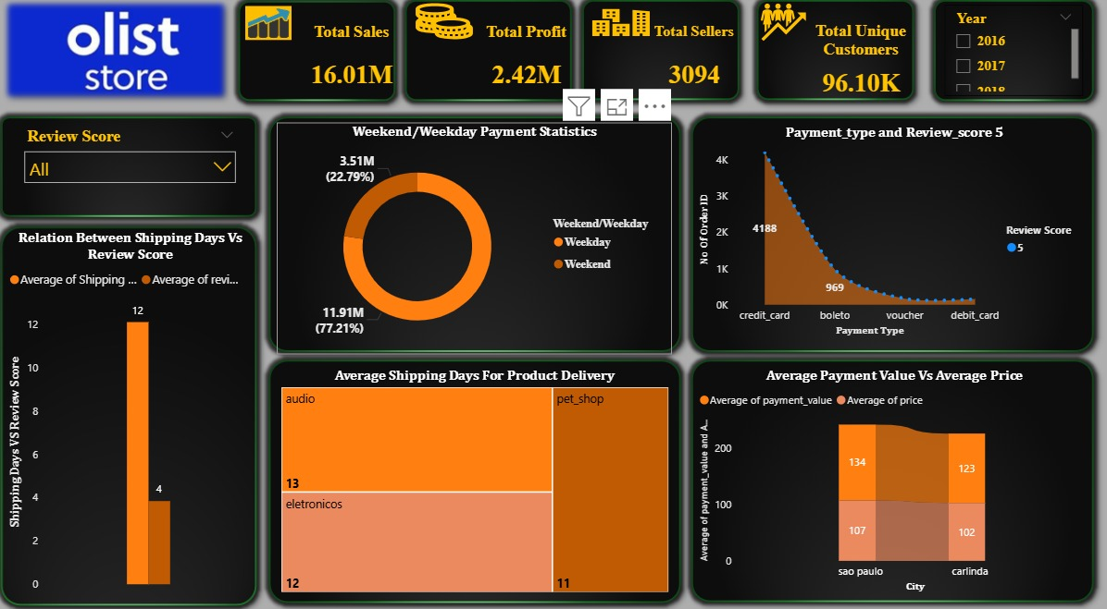
Power bi dashboard

Slide 14
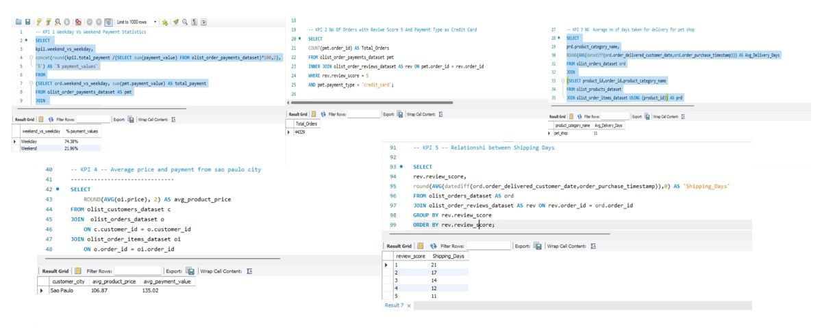
Sql queries

Slide 15
summary
Regular monitoring of customer reviews improves product quality & service.
Fleet performance tracking reduces delays and ensures timely deliveries.
Proper shipment tracking & communication builds trust with customers.
Data-driven insights support better decision-making and planning.
Delivery optimization enhances supply chain efficiency.
Customer-focused strategies boost satisfaction and loyalty.

Slide 16
conclusion
The Olist Store Analysis provides key insights into customer behavior & payment trends.
KPI analysis helps identify improvement areas and design targeted marketing campaigns.
Tools used: Excel & Power BI for data cleaning, manipulation & visualization.
Demonstrates how data analysis drives informed business decisions.

Slide 17
THANK YOU

